Slide 1


An Efficient Deep Learning Model for Stock Market Prediction
LSTM + Technical Indicators for Short-Term Forecasting
This project is funded by the LHVCCUC LSAMP Program
Ayobami Makinde & Arturo Franco
St.Joseph’s University, Brooklyn,NY
Advisor: Dr. Helen Dang
Molloy University, NY

Slide 2


The Problem: Why Predict Stock Prices?
Reasons:
Stock markets are highly volatile and influenced by complex factors
Accurate predictions help investors make informed decisions
Even small gains in forecasting accuracy can lead to significant financial returns
Deep learning offers the ability to model nonlinear and hidden patterns in price movements

Slide 3

The Solution We Made
Deep Learning Approach:
Built an LSTM ( Long Short-Term Memory) model with 100-day lookback windows.
Added technical indicators (RSI, MACD, Bollinger Bands).
Integrated self-attention to focus on key time steps.
Evaluated using MAE, RMSE, and candlestick visualizations.

Slide 4
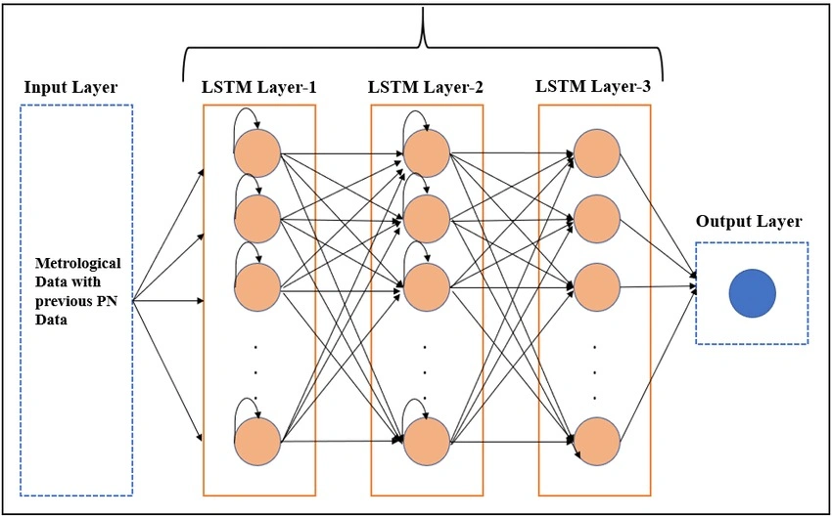
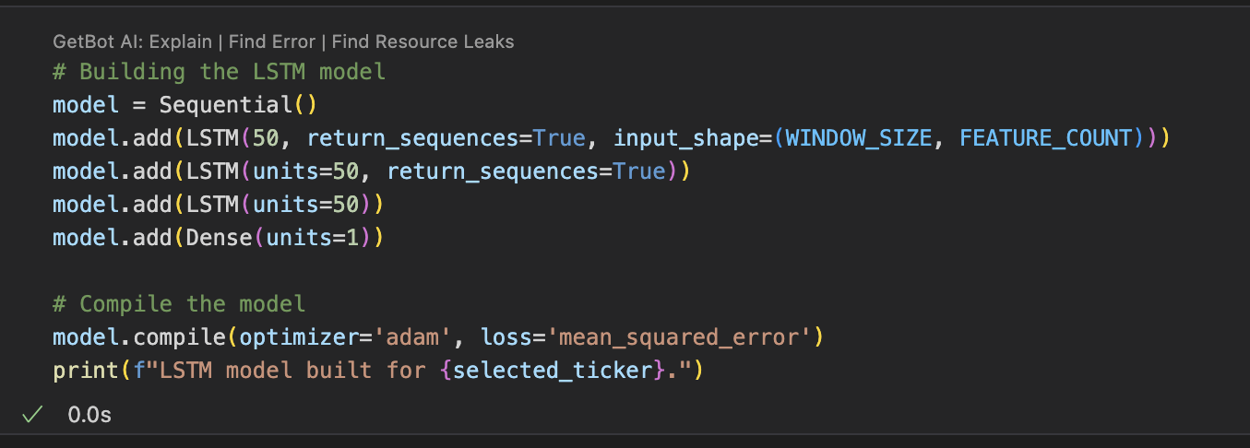
Deep Learning Model Pt 1
Features:
-3 LSTM layers → Dense layer
-The added Self-Attention for focus on important time steps
-Made a select ticker button to choose stock
-Uses past 100 days

Slide 5
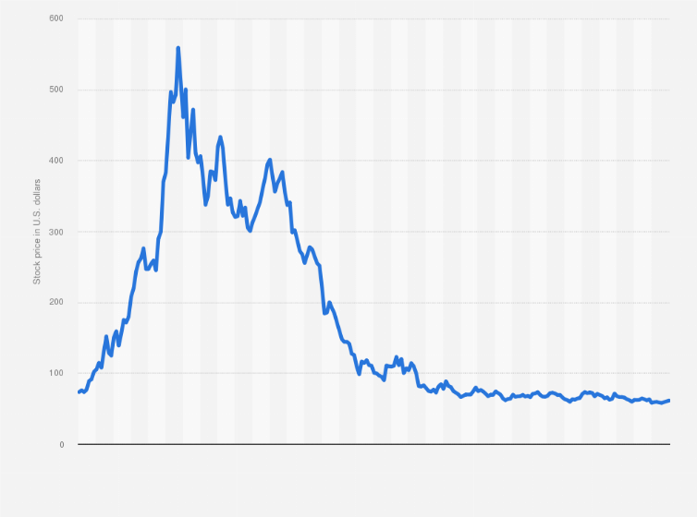
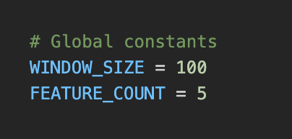
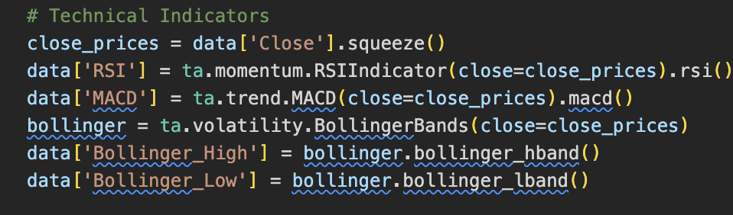
Deep Learning Model Pt 2
Data Collection:
- Made Global Constants:
Window size: 100 days
Feature count: 5 indicators
-To predict next 4 days
-Included more indicators: RSI, MACD, Bollinger Bands

Slide 6
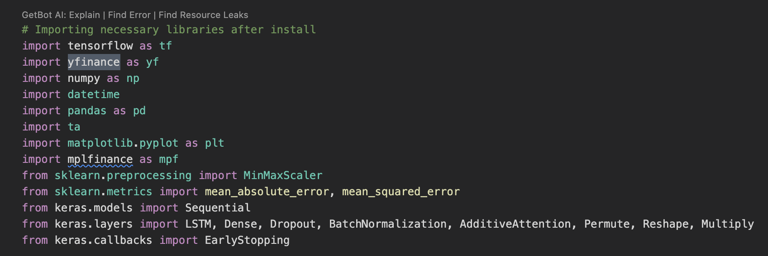
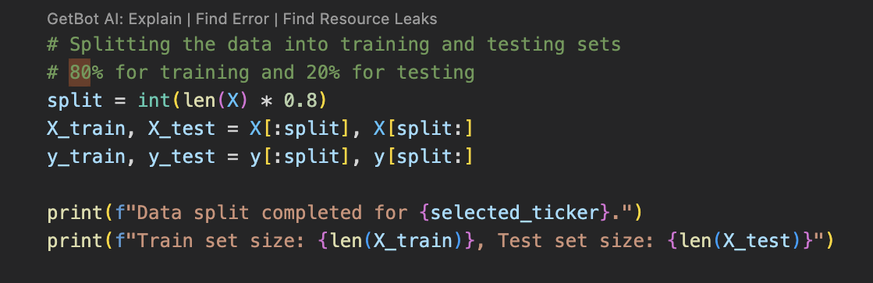
Dataset & Preprocessing
-Used yfinance data from 2020 to present (daily resolution).
-Scaled features using MinMaxScaler.
-Split: 80% training, 20% testing.

Slide 7
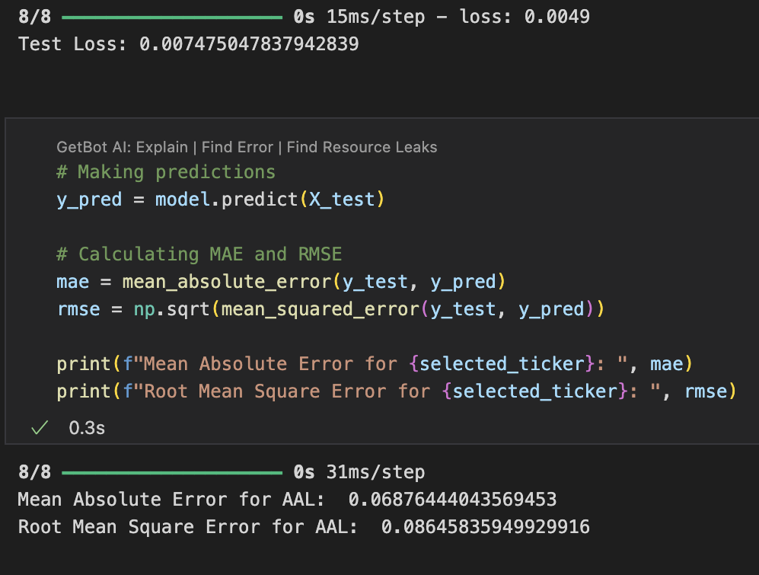
Performance Metrics
Metrics:
-MAE: ~0.069
-RMSE: ~0.086
-Test loss: ~0.0075 (on scaled data) → Shows relatively low error.

Slide 8
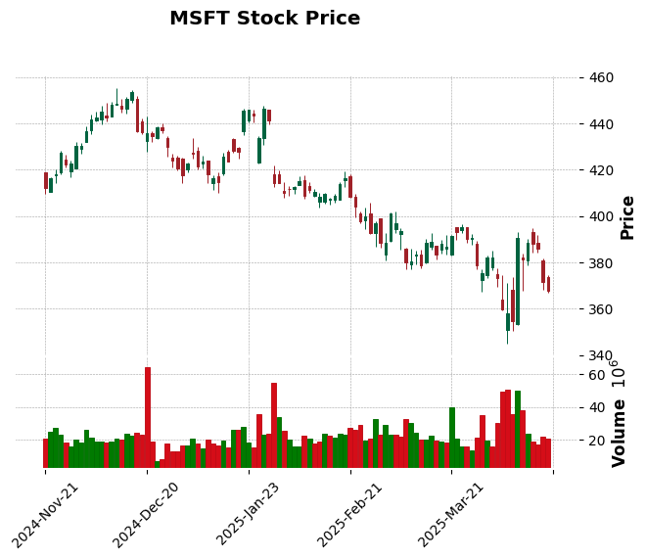
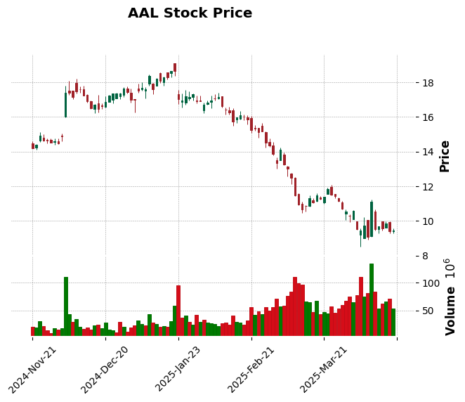
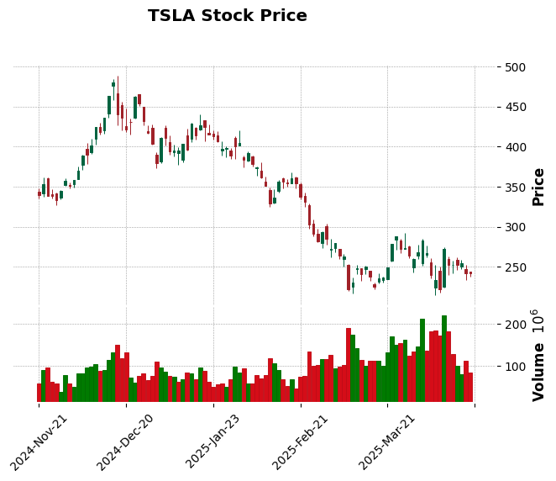
Visual Results:
Improvements 3 & 4
Fixed scaling bugs for realistic predictions.
Visualized results with candlestick charts
Improvements 1 & 2
AAL- American Airlines
MSFT- Microsoft
TSLA- Tesla
Changed Close-only → to 5 key features and 60-day → 100-day input window. Added self-attention to improve temporal focus

Slide 9

Thank You
Any
Questions?

